Slide 1
The Title

Slide 2


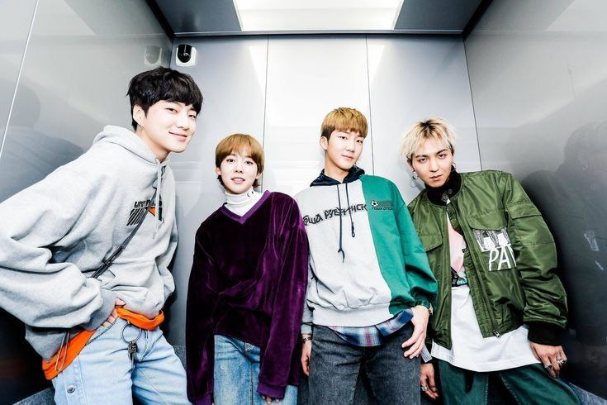
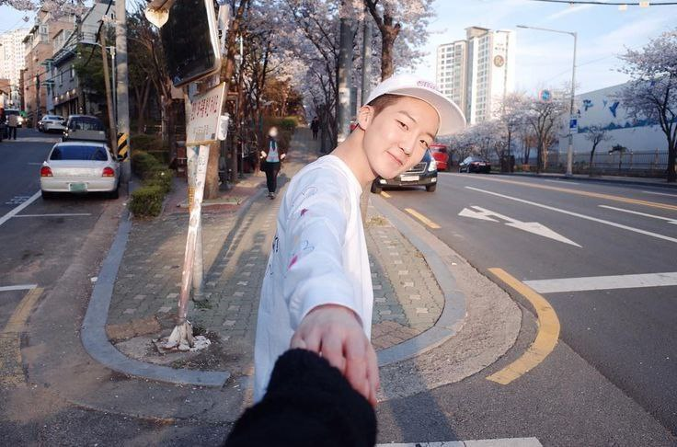


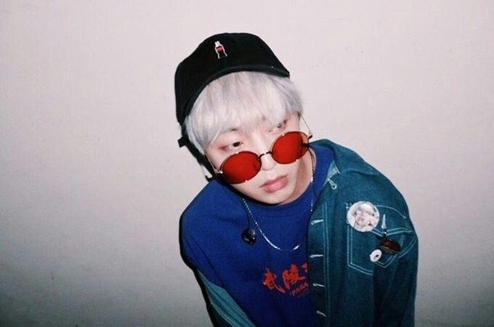
YouTube
How to how to when to how?
Home
Group Members
Trending
Subscription
Library
Song Mino
Mimop
Lee Seunghoon
History
Watch later
Kim Jinwoo
Park Inseo
Kang Seungyoon

Slide 3
YouTube
Insert the title here
The presentation is about the presentation about the presentation about the presentation about the presentation about the presentation about the presentation .
Next topic.
Next topic.
Next topic.

Slide 4
YouTube
Insert the title here
This is the first point.
This is the second point.
This is the third point.
This is just reminder that Kang Seungyoon solo album on March.
Next topic.
Next topic.
Next topic.

Slide 5
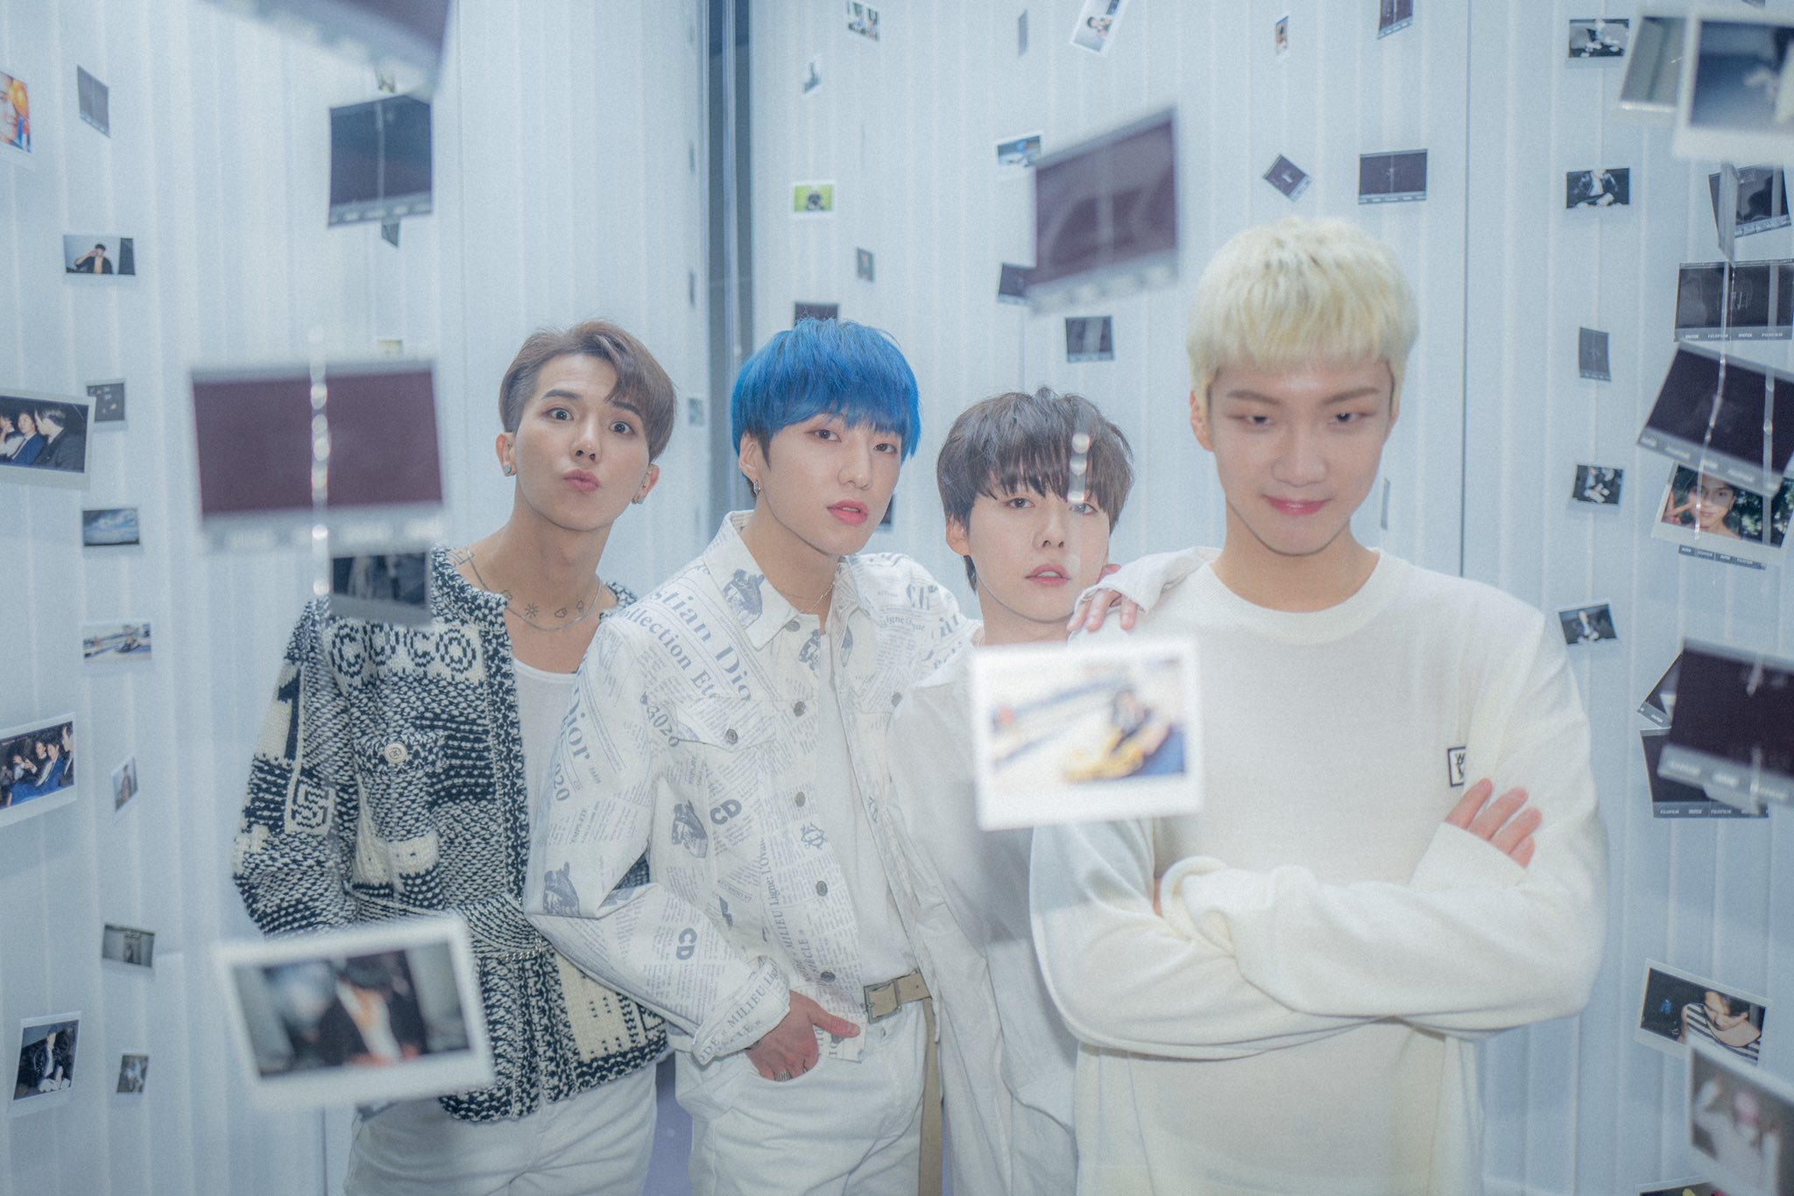
YouTube
Insert the title here
Next topic.
Next topic.
Insert video or picture here.
Next topic.

